Slide 1
Cornerstone City Church Peninsula Plus Community Hoo Are Ya 19-03-2023

Slide 2
I reach Up High
CCLI Song # 1075387
Judy Bailey
© 1993 Song Solutions Daybreak (Admin. by Song Solutions www.songsolutions.org)
For use solely with the SongSelect® Terms of Use. All rights reserved. www.ccli.com
CCLI Licence No. 33265

Slide 3
1/3
I reach up high I touch the ground
I stomp my feet and turn around
I've got to (woo woo) Praise the Lord
I jump and dance with all my might
I might look funny but that's alright
I've got to (woo woo)
Praise my Lord

Slide 4
2/3
I'll do anything just for my God
'Cause He's done ev'rything for me
It doesn't matter who is looking on
Jesus is the person that I want to please

Slide 5
3/3
May my whole life be a song of praise
To worship God in ev'ry way
In this song the actions praise His name
I want my actions ev'ry day to do the same

Slide 6
Open The Eyes of My Heart
CCLI Song # 2298355
Paul Baloche
© 1997 Integrity's Hosanna! Music (Admin. by Integrity Music Ltd)
For use solely with the SongSelect® Terms of Use. All rights reserved. www.ccli.com
CCLI Licence No. 33265

Slide 7
1/3
Open the eyes of my heart Lord
Open the eyes of my heart
I want to see You
I want to see You

Slide 8
2/3
To see You high and lifted up
Shining in the light of Your glory
Pour out Your power and love
As we sing holy holy holy

Slide 9
3/3
Holy holy holy
Holy holy holy
Holy holy holy
I want to see You

Slide 10


Slide 11
Firm Foundation (He Won't)
CCLI Song # 7188203
Austin Davis | Chandler Moore | Cody Carnes
© 2021 For Humans Publishing (Admin by Essential Music Publishing)
Maverick City Publishing (Admin by Essential Music Publishing)
Capitol CMG Paragon (Admin. by Capitol CMG Publishing)
TBCO Publishing (Admin. by Capitol CMG Publishing)
Writer's Roof Publishing (Admin. by Capitol CMG Publishing)
A.L.K.D. Music (Admin. by Watershed Music Group (Admin. by Capitol CMG Publishing))
For use solely with the SongSelect® Terms of Use. All rights reserved. www.ccli.com
CCLI Licence No. 33265

Slide 12
1/6
Christ is my firm foundation
The rock on which I stand
When everything around me is shaken
I've never been more glad
That I put my faith in Jesus
'Cause He's never let me down
He's faithful through generations
So why would He fail now

Slide 13
2/6
He won’t
He won't

Slide 14
3/6
I've still got joy in chaos
I've got peace that makes no sense
So I won't be going under
I'm not held by my own strength
'Cause I've built my life on Jesus
He's never let me down
He's faithful in every season
So why would He fail now

Slide 15
4/6
He won’t He won't
He won't fail
He won't fail

Slide 16
5/6
Rain came and wind blew
My house was built on You
I'm safe with You
I'm going to make it through

Slide 17
6/6
I'm going to make it through
‘Cause I’m standing strong on You
I’m going to make it through
‘Cause my house is built on You

Slide 19
Waiting Here For You
CCLI Song # 5925663
Chris Tomlin | Jesse Reeves | Martin Smith
© 2011 Rising Springs Music (Admin. by Capitol CMG Publishing)
Vamos Publishing (Admin. by Capitol CMG Publishing)
worshiptogether.com songs (Admin. by Capitol CMG Publishing)
Smith United (Admin. by Integrity Music Ltd)
Thankyou Music (Admin. by Integrity Music Ltd)
For use solely with the SongSelect® Terms of Use. All rights reserved. www.ccli.com
CCLI Licence No. 33265

Slide 20
1/6
If faith can move the mountains
Let the mountains move
We come with expectation
Waiting here for You
Waiting here for You

Slide 21
2/6
You're the Lord of all creation
And still You know my heart
The Author of salvation
You've loved us from the start

Slide 22
3/6
Waiting here for You with our hands
Lifted high in praise
And it's You we adore
Singing alleluia

Slide 23
4/6
You are ev'rything You've promised
Your faithfulness is true
We're desp'rate for Your presence
All we need is You

Slide 24
5/6
Singing alleluia alleluia
Singing alleluia alleluia

Slide 25
6/6
Waiting here for You with our hands
Lifted high in praise
And it's You we adore singing alleluia
(We’re) singing alleluia

Slide 28


Slide 29


Slide 30
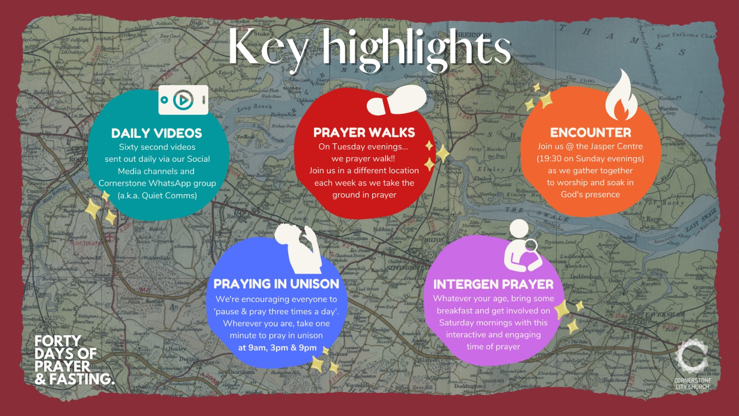

Slide 31


Slide 32
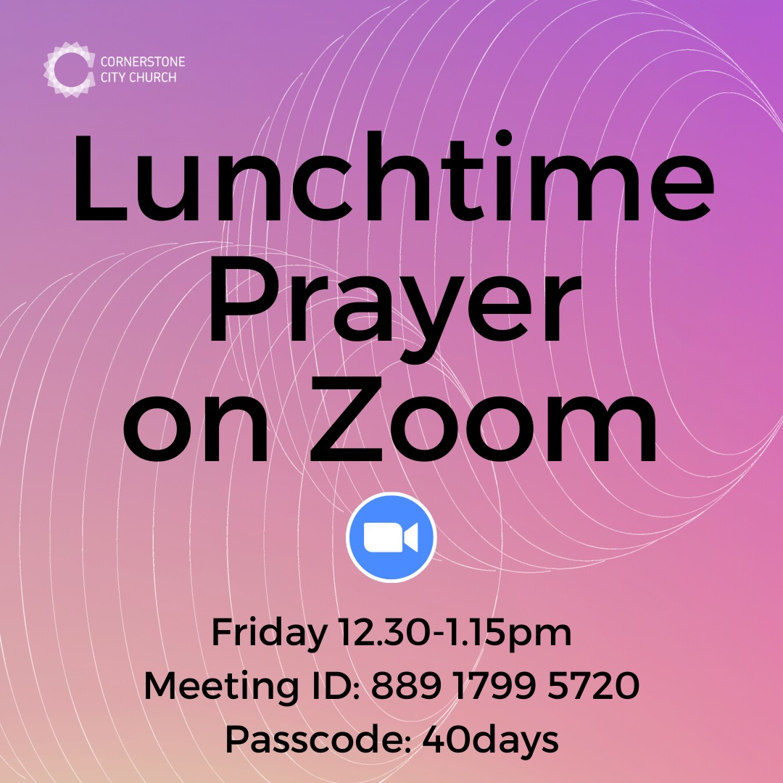

Slide 33


Slide 34


Slide 35

Notes:
Save the dates
Mums and dads, carers and grandparents - you are invited to join Susie, Tom and Jasmine on a Parenting for Faith course.
Parenting is so overwhelming sometimes isn't it? (Or is it just me?! 😅)
We so want our children to grow up knowing and loving God. Let's come together to seek our Father's help and learn from each other along the way.
There will be a couple of in person sessions, and some over Zoom, because we want to make it as accessible as possible.Special plea to Dads - I'd love your company too if you can make it!
Watch the video for more info 👆🏻
Contact Susie (susie@cornerstonecity.co.uk) or Tom (tom@cornerstonecity.co.uk) to find out more.

Slide 36


Slide 37


Slide 38
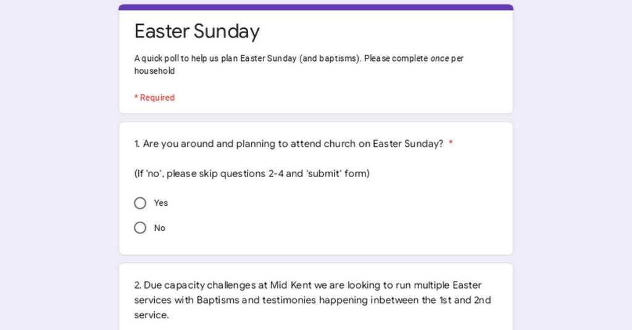

Slide 40
Lead Me To The Cross
CCLI Song # 4785828
Brooke Ligertwood
© 2006 Hillsong Music Publishing Australia (Admin. by Hillsong Music Publishing UK)
For use solely with the SongSelect® Terms of Use. All rights reserved. www.ccli.com
CCLI Licence No. 33265

Slide 41
1/5
Saviour I come quiet my soul
Remember redemption's hill
Where Your blood was spilled
For my ransom

Slide 42
2/5
Ev’rything I once held dear
I count it all as loss

Slide 43
3/5
Lead me to the cross
Where Your love poured out
Bring me to my knees
Lord I lay me down
Rid me of myself
I belong to You
Oh lead me lead me to the cross

Slide 44
4/5
You were as I tempted and tried human
The word became flesh
Bore my sin in death
Now You're risen

Slide 45
5/5
To Your heart
To Your heart
Lead me to Your heart
Lead me to Your heart

